Slide 1
ANL252 – Assessments, weightage, deadlines
Time frame and Deliverables
Assessment | Weightage | Start date | Deadline
Pre-Course Quiz 1 | 2% | 19 July, 12pm | 30 July, 12pm
Pre-Class Quiz 1 | 2% | 2 Aug, 12pm | 9 Aug, 12pm
Pre-Class Quiz 2 | 2% | 16 Aug, 12pm | 23 Aug, 12pm
Tutor Marked Assignment | 18% |  | 8 Aug, 1155 pm
Group Based Assessment | 20% |  | 22 Aug, 1155 pm
End-of-Course Assessment | 50% |  | 6 September 2021, 12 pm
Participation | 6% (30% from class, 70% from forum)

Slide 2
Python for Data Analytics ANL 252
Faculty: Dr. Munish Kumar
Session 3: Arrays & Plots
August 2021

Slide 3
Learning Objectives of ANL201
By the end of this Session
Explain the operations on arrays
Analyse data using appropriate tools for data visualisation

Slide 4
Study Unit 3 Arrays and Plots

Slide 5
Introduction to JupyterLab

Slide 6
Introduction to JupyterLab
JupyterLab is a web application specialised in data analytics using Python.
JupyterLab can be used to create Python code for
cleaning and transforming data
running numerical simulation
performing statistical modelling
data visualisation
machine learning
Notes:
Usually, we write our programs in Atom first and run them in terminal apps such as PowerShell or Command Prompt for general programming.
Here, we will focus on Python programming for data analytics. For this purpose, we will work with another Python programming environment called the JupyterLab.
While Atom is more a Python code editor in the traditional sense, JupyterLab is an open-source web application specialised in data analytics using Python.
It is the newest Python programming interface developed by Project Jupyter.
We can use it to create code for cleaning and transforming data, running numerical simulation, performing statistical modelling, data visualisation and machine learning.

Slide 7
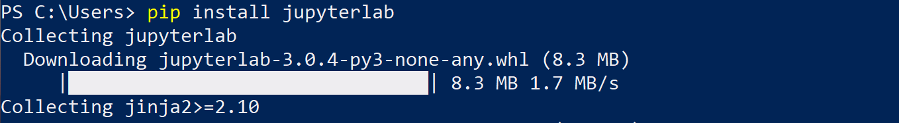
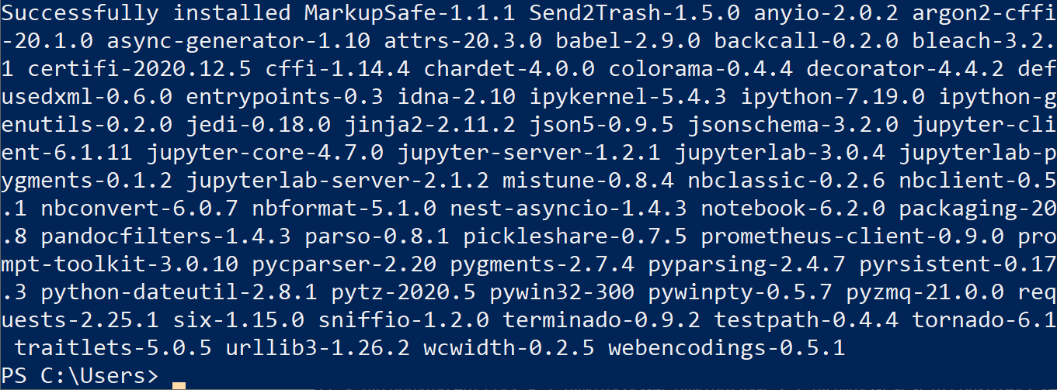
Install JupyterLab
Install JupyterLab using pip in the terminal apps.
pip install jupyterlab
Notes:
Before we can start working with JupyterLab, we need to install it on our computer so that it can be integrated in the Python environment.
The pip install command refers to the same Python installer program introduced for package installation. Instead of a package, JupyterLab is the object to be installed here.
The installation could take quite a while since there are many packages that JupyterLab requires for its functionalities, and they will therefore be installed together.
The message “Successfully installed …” will appear on the terminal apps once the installation of JupyterLab has completed.

Slide 8
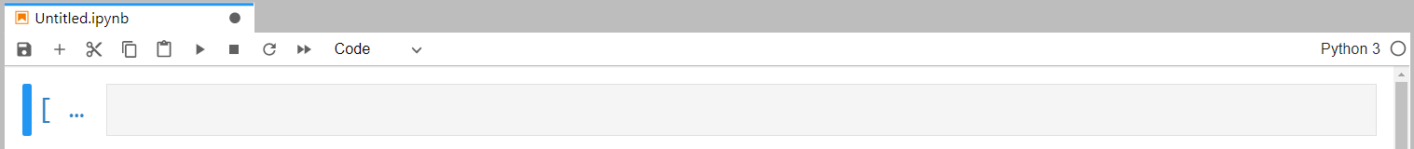
Start JupyterLab
Start terminal apps and change to the folder where the Python scripts are stored.
Launch JupyterLab by the command:
Normally, JupyterLab is launched automatically in the internet browser.
If it does not start by itself, start the internet browser manually and type in the following URL in the address bar:
Press “Python 3” in the “Notebook” rubric to start a new Python script.
jupyter lab
localhost:8888/lab
Notes:
To launch JupyterLab, we need to start the terminal apps again, change to the folder where you have saved all your Python scripts, and then launch the JupyterLab.
The messages appearing in the terminal apps are no longer relevant to our work, unless we receive an error message from Python for loading JupyterLab.
Under normal circumstances, the JupyterLab environment will be launched automatically in a new window or a new tab of the standard internet browser.
If it does not start by itself, we can start the internet browser manually and type localhost:8888/lab in the address bar.
The start-up page of JupyterLab will then be loaded.
To start a new Python script, you can press on the “Python 3” button in the “Notebook” rubric. And a new tab will appear in JupyterLab.
When this page appears, we can start writing our program in the blue field.

Slide 9
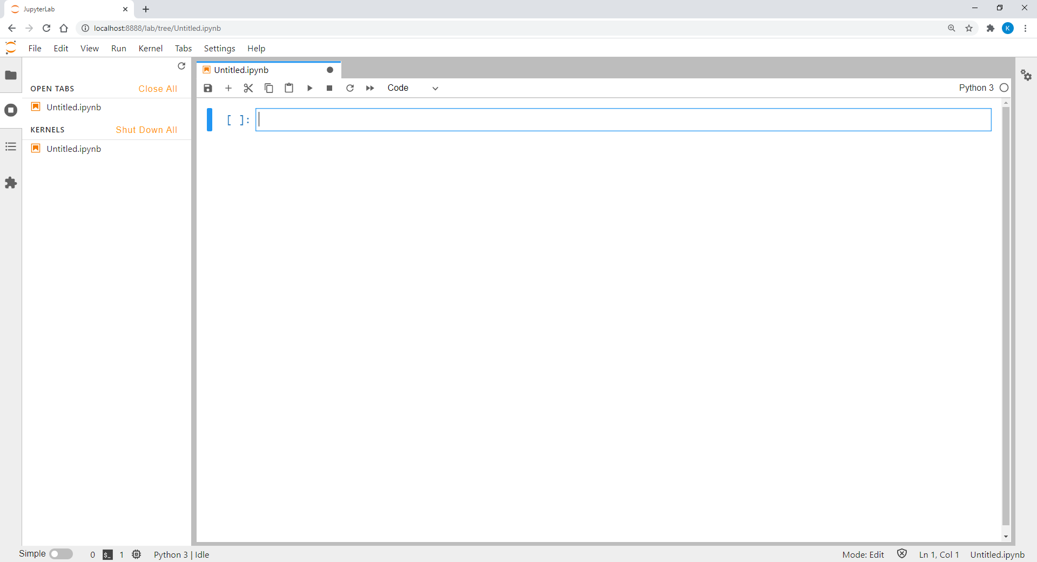
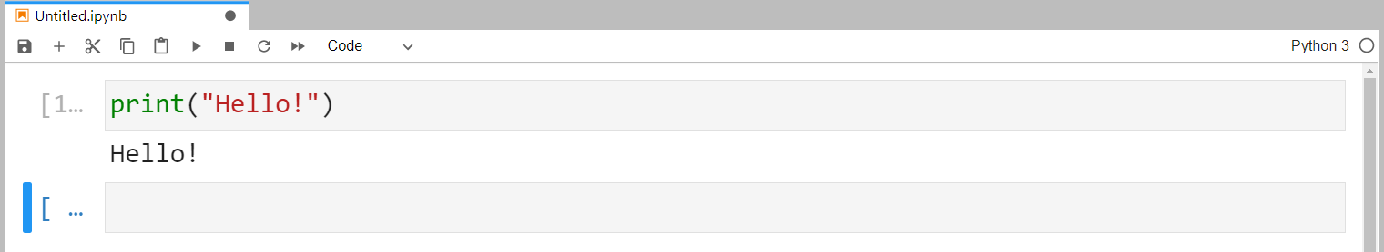
Programming with JupyterLab
Python program in JupyterLab cell can be executed by clicking or pressing CTRL + ENTER.
The output of the program script will then be printed below the input box.
Notes:
Each Python program written in a JupyterLab cell can be executed by clicking “RUN” or pressing the key combination CTRL + ENTER. The output of the program script will then be printed below the input box.

Slide 10
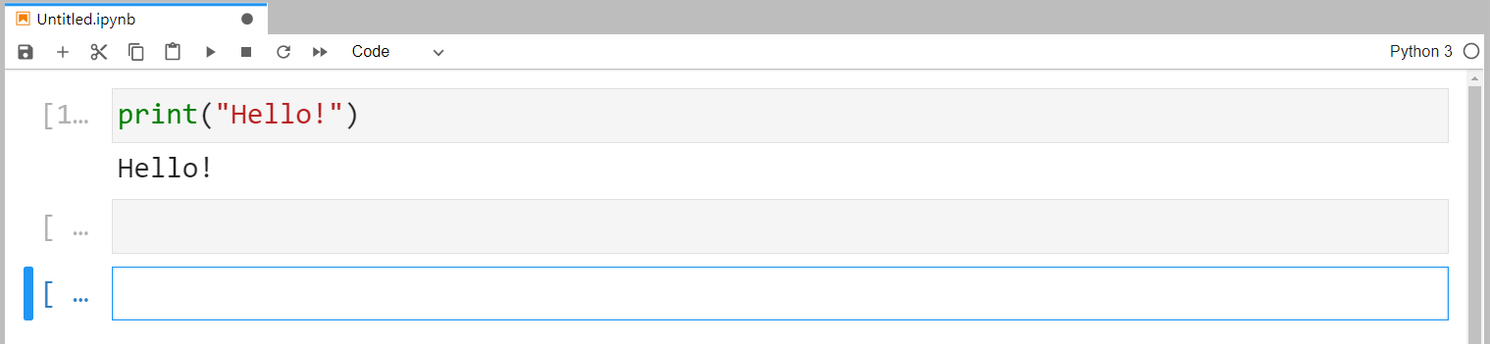
Writing and Running Codes in Cells
To add a new cell, press .
We can go back to previous cells any time and modify the code there.
Normally, JupyterLab only executes code of one cell.
We can run the code flexibly regardless the sequence of the cells.
To run all cells, go to “Kernel” and select “Restart Kernel & Run All Cells…”.
In this case, the order of the cells becomes essential.
Notes:
After running the first script, JupyterLab will usually add a new cell for us to start another task. Nevertheless, we can also add it manually by pressing “ADD”.
Once a new cell has been inserted, we can write another set of script in it. We can also choose to go back to the previous cell and modify the code written there.
Note that in JupyterLab, Python only executes the code written in one cell. In other words, we can return to the “upper” cells and re-run the code there when it is necessary.
If we want to execute the programs in all cells, we can go to the “Kernel” menu and select “Restart Kernel & Run All Cells…”.
In this case, we have to pay attention to the sequence of the cells since the logical flow among them will become relevant.

Slide 11
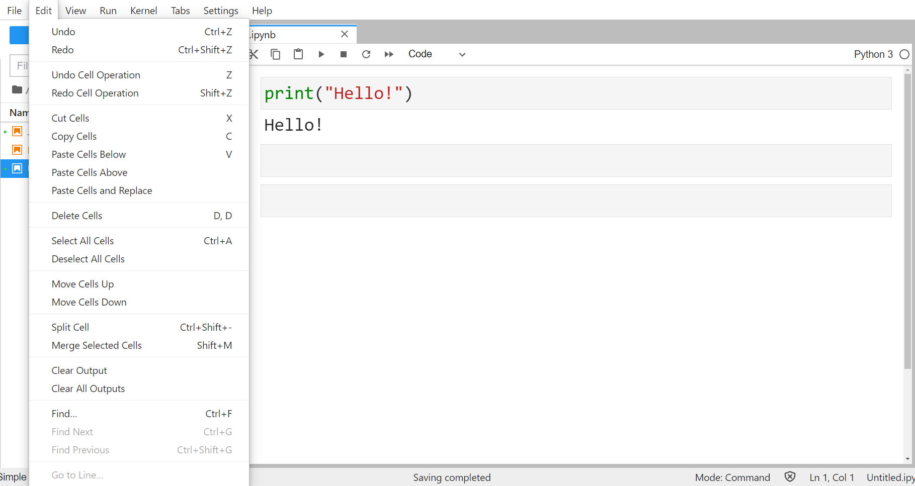
Edit JupyterLab Notebook
JupyterLab provides many functions to restructure our Python scripts.
Below is the “Edit” menu with all available options.
Notes:
In the “Edit” menu, there are many functions that JupyterLab provides us to restructure our Python scripts.
For example, we can switch the order of the cells by moving them up and down. We can also cut, copy, paste, and delete them. JupyterLab enables us to merge multiple cells into one or split a single cell into two or more cells as well.

Slide 12
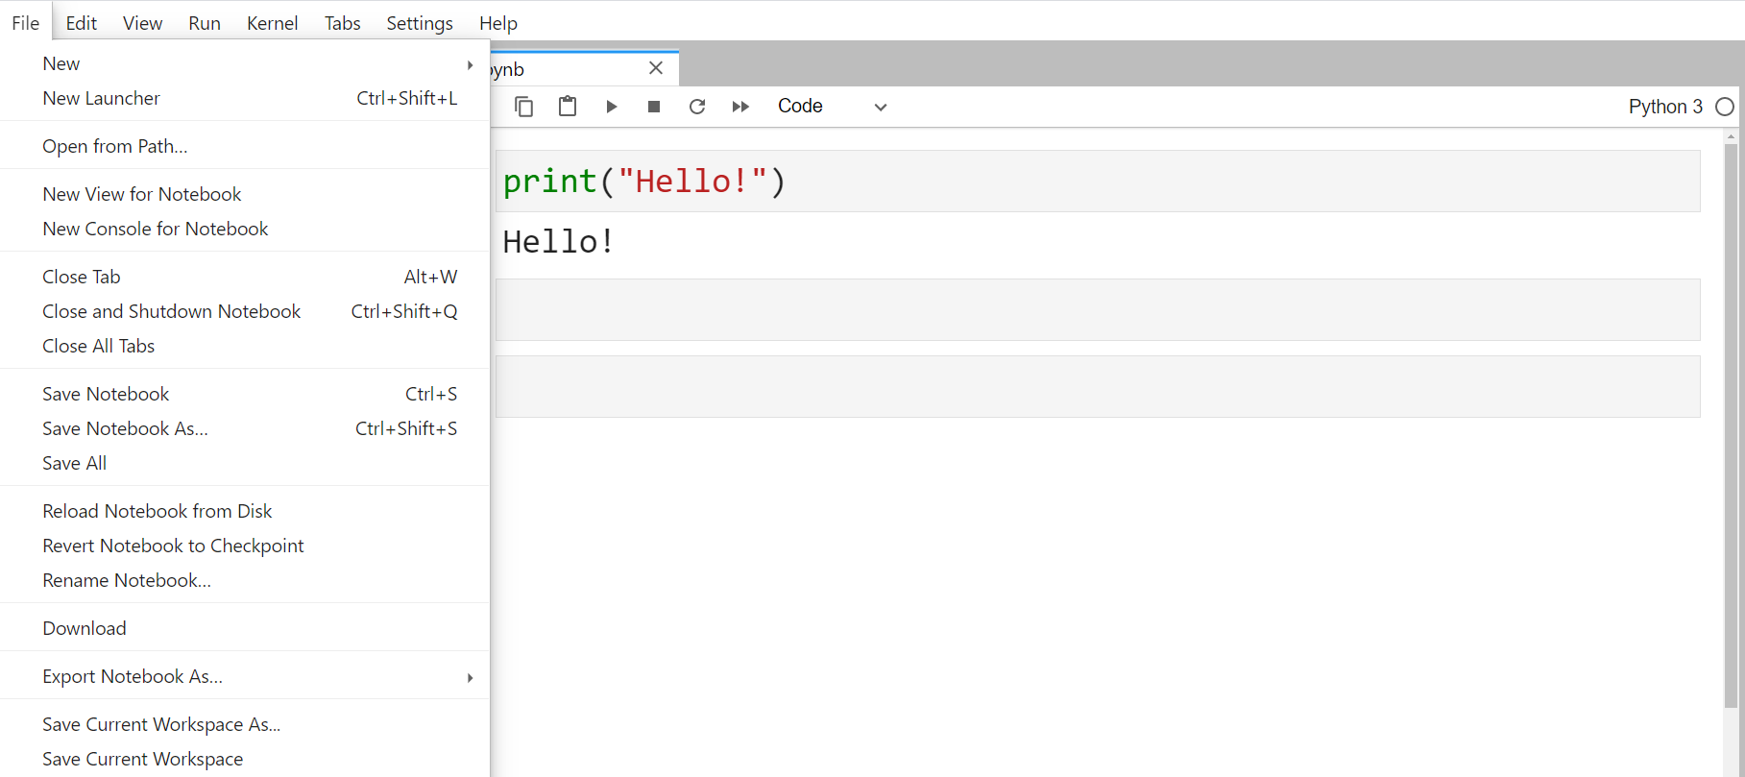
Save JupyterLab Notebook
Save JupyterLab notebook by pressing or “Save Notebook as…” in the “File” menu.
Notebook is saved as a “.ipynb” file in the folder where JupyterLab was started.
Notes:
To save a Python program in JupyterLab, we can either press the “SAVE” icon or choose “Save Notebook as…” in the “File” menu.
The file will then be saved with the “.ipynb” extension in the folder where JupyterLab was started in the terminal apps.

Slide 13
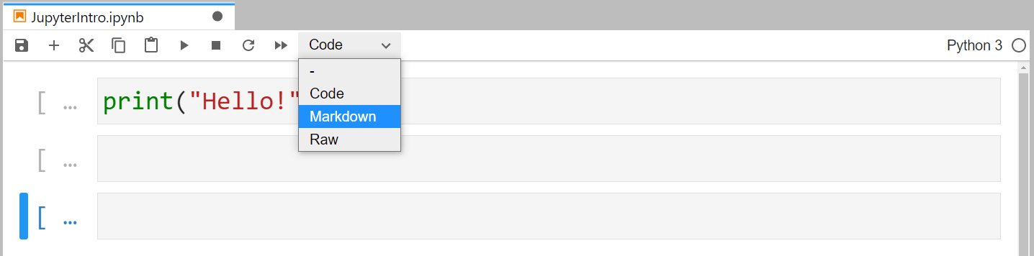
Markdown
JupyterLab can be used an advanced text editor.
Headers, elaborative texts, HTML codes, etc., all could be embedded in a JupyterLab notebook.
To create the corresponding format, switch the cell type from “Code” to “Markdown”.
Notes:
Another advantage of using JupyterLab is that we can use it as an advanced text editor.
Besides Python programs, we can also embed elaborative texts to the program or write HTML codes to design a website with it.
All we need for the start is to switch the cell type from “Code” to “Markdown”.

Slide 14
Activity
Start JupyterLab, open a new notebook and carry out the following tasks:
Carry out simple calculations such as 2 * (3 – 1.5²).
Print the result of the calculation using formatted printing in another cell.
Insert a markdown cell before the cell of step 1 and describe the calculation to be carried out.
Re-run all cells.
Save the notebook on the computer.

Slide 15
Discussion
What are the advantages of using JupyterLab for data analytics tasks in comparison to Atom?
What is the optimal size of a chuck of code in a single cell?

Slide 16
Array Management with NumPy

Slide 17
NumPy Package
Compound data such as lists, tuples, or dictionaries are one-dimensional.
Arrays should be used to store multidimensional data.
Array must be rectangular, i.e., number of values in each row and each column must be identical.
All values must be of the same type, typically numeric values or strings.
NumPy is the most common package in Python to work with arrays.
Notes:
Despite being able to group lists or tuples in a superordinate list, these types of compound data are basically still one-dimensional.
For example, the list of data for exam scores to be analysed can consist of either sub-lists with individual student scores from different subjects or the scores of all students in one subject in each one of them.
As a result, the data in this example are in fact two-dimensional: the student dimension and the subject dimension.
Hence, lists and dictionaries are no longer sufficient to store multidimensional data for analysis, and arrays should be used instead.
Nevertheless, we can also replace lists and dictionaries by arrays when it comes to one-dimensional data.
Note that the shape of a Python array must be rectangular, that is, the number of values in each row and each column must be identical, and all values in it must be entirely of the same type, typically numeric values or strings.
Therefore, an array is not equivalent to a dataset in the conventional sense since missing values and mixed data types are common features of usual datasets.
In Python, we can work with arrays using the “NumPy” package.

Slide 18
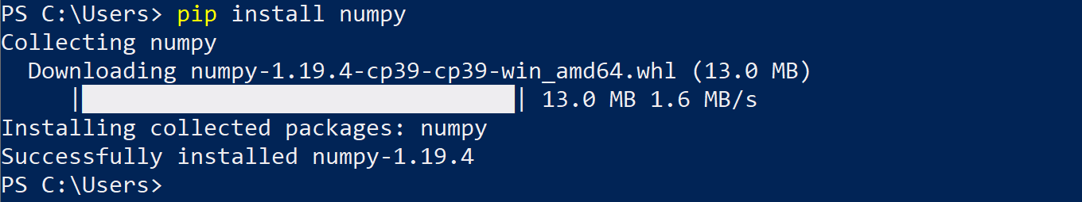
Install and Import NumPy Package
Install NumPy package with the pip package in the terminal apps.
Use the import statement to load “numpy” package in our program.
The most common alias for “numpy” is “np”.
pip install numpy
import numpy as np
Notes:
In order to work with NumPy arrays, we need to install the “numpy” package in Python first. We need to launch the terminal apps and type in the pip command.
Once the installation is completed, we can launch JupyterLab and start working with NumPy arrays after the “numpy” package has been imported into our program.
Recall that we can import a package with an alias, which will then be used as our reference to the package in the further part of our program. And for “numpy”, the most common alias used in the literature or online references is “np”.

Slide 19
Create Arrays
Use array() function to create n-dimensional NumPy arrays (ndarray).
Data in the array() function are stored in various regular Python lists.
Each list corresponds to a row of the array.
Number of elements in each list must be identical.
All lists in the array() function, separated by commas, must be wrapped by a pair of outer square brackets.
Each direction of an array is called an axis.
array_name = np.array([[list1_data1, list1_data2, …],
[list2_data1, list2_data2, …], …])
Notes:
To create an array, we can use the array() function.
In the above syntax, the array() function was attached to the np. prefix, which is required if NumPy is imported using the import-statement.
The prefix should be omitted if we use the from … import … statement to import the array function alone from NumPy instead.
The data assigned to array_name in the array() function are stored in various regular Python lists originally.
Each list corresponds to a row of the array, and the total number of rows is therefore equal to the number of lists included in the array() function.
Additionally, the number of elements in each list must be identical. If the lists have different lengths, an error message will appear.
Note that it is compulsory to wrap all the lists, separated by commas, in a pair of square brackets again before putting them into the array() function.
In NumPy, an n-dimensional array is also called an “ndarray”. And each direction of an array is also called an axis.
For instance, the rows or the columns are the two axes of a two-dimensional array, just like the coordinate system.

Slide 20
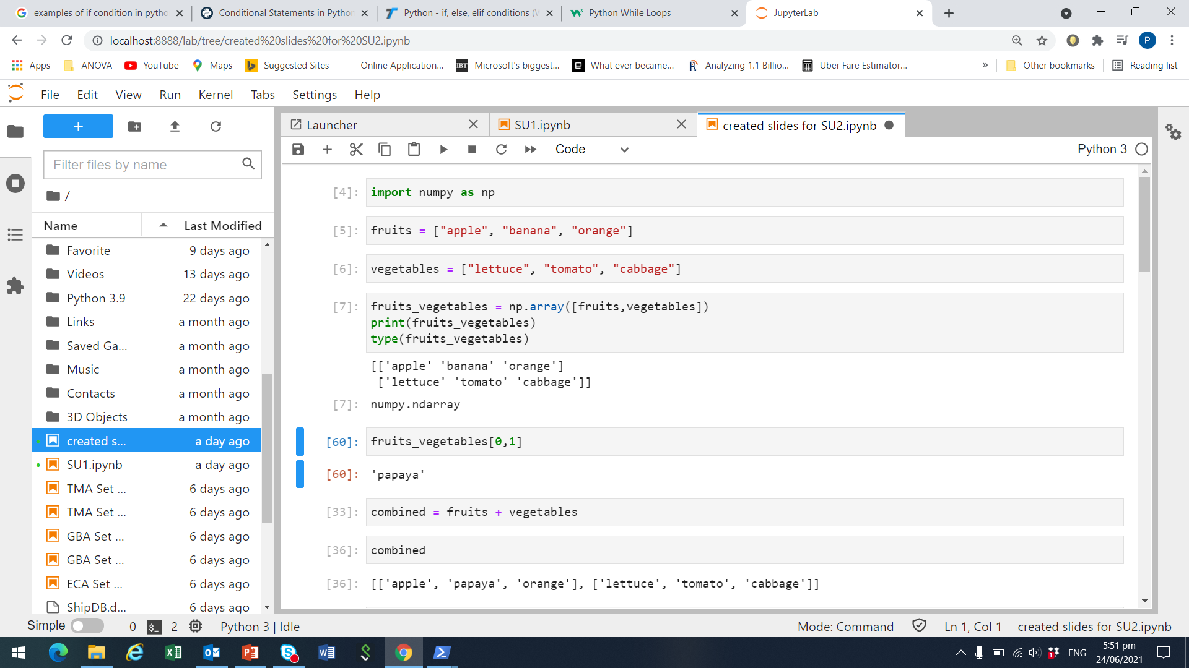
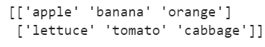
Example of 2 dimensional numpy array
Suppose we have two lists, fruits and vegetables
Combine fruits and vegetables into one numpy array
Print the array to take a look at its contents

Slide 21
Subset Arrays
Use index operator [] to access elements of an array.
Two ways to subset an array:
By index: Including multiple indexing, open-end indexing, negative indexing.
Boolean masking: Values of an array that fulfil certain conditions are selected in the subset.
Syntax for subsetting two-dimensional arrays:
The order of the indices in the index operator must follow the sequence of the axes (dimension).
array_name[row_index, column_index]
Notes:
We can use the index operator to access certain elements of an array just as indexing tuples, lists or dictionaries. And from there we can subset an array. Nonetheless, there are two ways to subset an array using the index operator.
Using index: Suppose we want to get the second value, so at index 1. The index starts with 0, same as Python List. Recall that if we intend to do multiple indexing like start:end, the end index will not be included in our array subset. Furthermore, negative indexing and open-end indexing are also allowed here.
Using Boolean masking: Suppose we want to get all values that are over 80. A first step is using array_name > 80 to produce a Boolean mask, where array_name can be any arbitrary name of an array. The result is a NumPy array with Boolean elements: True if the corresponding value is above 80, False if it is below. Subsequently, we can use the Boolean mask inside a pair of square brackets to do subsetting. Only those elements above 80, for which the corresponding Boolean mask is True, are selected. If for instance there are two values above 80, we will end up with a NumPy array with two values.
Since arrays can be multidimensional (ndarray), we can certainly subset every dimension of it by using multidimensional indexing.
Basically, the usage of the index operator here is just like subsetting a one-dimensional Python list. The only difference is that we can put a comma after the row indexing, and then continue with the column indexing.
The resulting subset of the array can be a single value, a row, a column, or an array with less rows and/or less columns.
For multidimensional NumPy arrays, the order of the indices in the index operator must follow the sequence of the axes, or dimensions, in an array.
For instance, axis one of a two-dimensional array refers to the rows and axis two to the columns.

Slide 22

Subsetting example
In our example, we created fruits_vegetables as a numpy array.
Row index: 0 is the fruits list, 1 is the vegetables list
Column index: 0 is the 1st element in a given list, 1 is the 2nd element…
To get ‘banana’ from fruits_vegetables, we need
row index = 0 (i.e., fruits list) and,
column index = 1 (i.e., 2nd element)

Slide 23
Array Properties
Check properties of an array using some NumPy functions and methods:
type(array_name)
array_name.ndim
array_name.shape
array_name.size
array_name.dtype
Notes:
We can also check various properties of an ndarray by some NumPy functions and methods.
The type() function indicates the type of our array.
The .ndim method returns the array’s number of dimensions, which is usually 2 in our case.
The .shape method provides the number of rows and columns of the given array.
And the .size method calculates the total number of elements in an array.
The .dtype method shows us the type of data contained in the array.

Slide 24
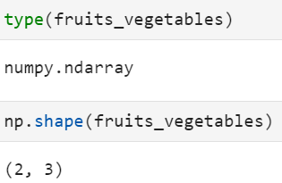
Example of array properties

Slide 25
Work with NumPy Arrays
NumPy provides various functions to us to work with arrays.
Each function deals with specific type of values in the array.
For instance, log() and sqrt() are only applicable to numeric arrays.
Functions like strip() and upper() are specifically designed for strings arrays.
Each function may have effect on different axes of the array.
Below are some examples of some frequently used NumPy functions.
Function | Description
percentile() | Return row, column, or array percentile
mean() | Return row, column, or array mean
exp() | Return exponential
random.ranf() | Return array with random floats in the interval [0, 1)
Notes:
The NumPy package does not only facilitate the creation and management of arrays, but it also provides functions for us to work with it.
Each function deals with specific type of variable. For instance, mathematical functions such as log() and sqrt() can only be applied on arrays with numeric values, whereas strip() and upper() are functions specifically designed for arrays with only strings in it.
We must also be aware of whether the effect of a function is elementwise, row wise, column wise, or array wise.
Having elementwise effects means that the function will be applied to all elements of an array individually.
Having effects on array means that the function will be operating with all the array elements at the same time.
Row wise and column wise effects indicate that the function will take all the elements from the same row or column into its operation. If an array has more than two dimensions, the row wise and column wise effects will become axes effects. That is, the functions can be applied in each direction of the array.

Slide 26
Activity
Random sampling program:
Generate a 10 x 10 array which contains 100 random numbers from the normally distributed population with mean 0 and variance 1.
Compute the mean, median and mode of each array column as well as the entire array.
Select those numbers from the array within the interval [-1.96, 1.96] and store those numbers in a one-dimensional array. Determine the size of the resulting array.

Slide 27
Discussion
When is it more sensible to use arrays instead of tuples, lists, or dictionaries? And when is it vice versa?
Why do some NumPy functions require the whole axis or array for its process and why some of them do not?

Slide 28
Plotting with matplotlib

Slide 29
matplotlib Package
“matplotlib” is the most common visualisation package for Python.
The sub-package “pyplot” contains all functions and plot types we need here, e.g., bar chart, histogram, scatter plot, etc.
Use the following syntax to import “pyplot” into a program:
import matplotlib.pyplot as plt
Notes:
The most common visualisation package in Python is “matplotlib”. Its sub-package named “pyplot” contains all the functions that we need.
The sub-package “matplotlib.pyplot” will be imported instead of the whole package matplotlib.
We use the alias “plt” here, which is also commonly found in literatures and websites, since it is short and has a clear reference to “pyplot”. Note that the above syntax has only instructed Python to import the sub-package ”pyplot”. All the other functions and sub-packages of matplotlib are not imported.
The sub-package “matplotlib.pyplot” provides many different plot types. The most common ones such as histogram, bar charts and scatter plots are included. We can customise each plot by changing colours, shapes, labels, axes, etc. according to our own needs and taste. In the following, we will introduce some basic plotting techniques based on a line plot.

Slide 30
Create Plots
Use plot() function to create simple line plot.
The function parameters control:
x, y: lists of the x-axis and y-axis values
color: colour of the line
linestyle, linewidth: formatting options of the line.
marker: style of the data points, e.g., point, circle, square, etc.
markerfacecolor, markeredgecolor and markersize: colour and size of data points.
Refer to https://matplotlib.org/api/_as_gen/matplotlib.pyplot.plot.html for more arguments of the plot() function.
plt.plot(x, y, color, linestyle, linewidth, marker,
markerfacecolor, markeredgecolor, markersize)
Notes:
Use the plot() function to create simple line plot.
The argument x is a list of x-axis value. Correspondingly, y is a list of the y-axis value.
The argument color is a string to indicate the colour of the line to be plotted such as “blue”, “red”, etc.
The arguments linestyle and linewidth control whether the line should be solid, dashed, dotted, etc., and how thin or thick it should be.
We can also choose the style of the marker of the data points on the line chart such as point, circle, square, etc. with the marker argument.
We can also fix the colour and size of the marker with the arguments markerfacecolor, markeredgecolor and markersize.
There are actually more arguments available for the plot() function. You can refer to the official website of the pyplot sub-package for further information.

Slide 31
Other Plot Options
Apply .xlabel() and .ylabel() methods to add labels to both axis.
Set a title to the current plot by title().
We can define the text and location of the labels on each tick of both axes.
Python waits for show() to display all figures.
plt.xlabel("My X-Label String")
plt.ylabel("My Y-Label String")
plt.title("My Plot Title")
plt.xticks(ticks, labels, rotation)
plt.yticks(ticks, labels, rotation)
plt.show()
Notes:
To label the axes, we can use the xlabel() and ylabel() functions.
We can also set a title to the current plot using the title() function.
Another useful plot customisation is to define the text and location of the labels on each tick of the x-axis and y-axis.
A list of the labels assigned to the argument labels will be plotted on the locations defined with the argument ticks. We can also rotate the labels in case they fit optically better to the plot if they are slanted. A numeric value representing the degree of rotation can be assigned to the argument rotation.
Python will wait for the show() function to actually display all figures.
Note that since our programs here are constructed and run in JupyterLab, the plots will anyway be displayed if we put all the syntaxes for plotting in one cell so that they can be executed in the same run.
As a result, we will not actually need the show() function in the last step.
However, this function is the final instruction to display the figures if we run the plotting syntaxes in the original Python program.

Slide 32
Histogram
Histogram shows the distribution of a variable.
With the hist() function, we can control
number of bins,
range of values,
chart’s orientation,
width of the bars,
position of the bars (between two ticks or on top of a tick),
colour of the bars.
plt.hist(x, bins = None, range = None, align = "mid", orientation = "vertical", rwidth = None, color = None)
Notes:
The histogram is another common type of plots in data analytics.
It shows the distribution of variables by plotting the frequencies that certain ranges of value occur in a sample.
The hist() function has many arguments for the control of the histogram layout.
The introduction here only includes the most common ones.
For instance, we can decide how many bins (bars) and which range of the values it should contain.
We can also choose to have a histogram with horizontal bars by changing the orientation argument.
With the arguments such as rwidth, which represents the width of the bars, align, with which we can position the bars between two ticks or on top of a tick, and color, we can format the bars according to our needs.

Slide 33
Scatter Plot
Scatter plots are used to study the correlation between two variables.
The parameters of the scatter() function control
values of x and y,
colour and style of the markers,
width and colour of the markers’ edge.
plt.scatter(x, y, color = None, marker = None, linewidths = None, edgecolors = None)
Notes:
Scatter plots are often used to study the relationship between two variables, which is usually referred as their correlation.
The values of the first variable are plotted in the x-axis and the values of the second variable in the y-axis.
If the data dots are scatted around the 45 degrees line of the chart, we can conclude that these variables are correlated with each other.
Same as the hist() function, we only list out some of the most common arguments of the scatter() function here.
For instance, we can change the colour and style of the markers, assign another colour to the markers’ edge, and adjust its width for more sophisticated visualisation.
You can refer to official website of the pyplot sub-package to find out more available arguments to control the scatter plot layout.

Slide 34
Activity (I)
Random sampling program:
Generate a histogram of the 100 random numbers drawn in the previous Chapter. Provide a title as well as labels for both axes in the chart.

Slide 35
Activity (II)
Random sampling program:
The following array contains the 0.01 to 0.99 quantiles of the standard normal distribution:
(-2.33, -2.06, -1.88, -1.75, -1.65, -1.56, -1.48, -1.41, -1.35, -1.29, -1.23, -1.18, -1.13,
-1.09, -1.04, -1.00, -0.96, -0.92, -0.88, -0.85, -0.81, -0.78, -0.75, -0.71, -0.68, -0.65,
-0.62, -0.59, -0.56, -0.53, -0.50, -0.48, -0.45, -0.42, -0.39, -0.37, -0.34, -0.32, -0.29,
-0.26, -0.24, -0.21, -0.19, -0.16, -0.14, -0.11, -0.09, -0.06, -0.04, -0.01, 0.01, 0.04, 0.06,
0.09, 0.11, 0.14, 0.16, 0.19, 0.21, 0.24, 0.26, 0.29, 0.32, 0.34, 0.37, 0.39, 0.42, 0.45,
0.48, 0.50, 0.53, 0.56, 0.59, 0.62, 0.65, 0.68, 0.71, 0.75, 0.78, 0.81, 0.85, 0.88, 0.92,
0.96, 1.00, 1.04, 1.09, 1.13, 1.18, 1.23, 1.29, 1.35, 1.41, 1.48, 1.56, 1.65, 1.75, 1.88,
2.06, 2.33)
Generate a scatter plot with the quantiles of the standard normal distribution as the values of the x-axis and the drawn sample (after sorting in the ascending order) as the values of the y-axis.
Draw a 45-degree red line to go through all the scatter plot.

Slide 36
Discussion
What are the additional matplotlib functions that can help us to improve the visualisation of our charts? Why are they optional but necessary?
Name some situations in which a line chart, or a histogram, or a scatter plot is more suitable than other plot types for data visualisation.

